Slide 1

Introduction to Bioconductor (1)
Antonio Mora
Bioinformatics Lab Workshop, 24/05/2019

Slide 2

Summary
What is Bioconductor?
Working with sequences
Working with coordinates
SummarizedExperiment (not included in lab)

Slide 3
1. What is Bioconductor?

Slide 4

Bioconductor is a collection of more than 1,500 R packages for high-throughput omics analyses.
Authors build packages (for free), according to some guidelines, and different mirror sites in the world host them.
There are some basic packages and some packages for specific bioinformatics tasks. One of the tenets of Bioconductor is to use the basic packages, and other bioinformatics packages, to create your own.
Bioconductor also offers educational material (courses) and workflows for specific tasks, in addition to all the package vignettes.

Slide 5
2. Working with Sequences

Slide 6
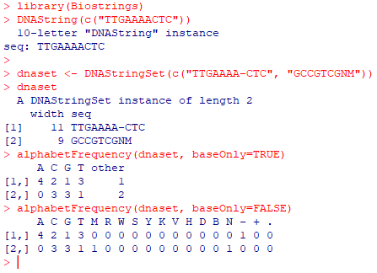
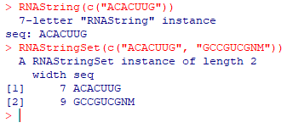
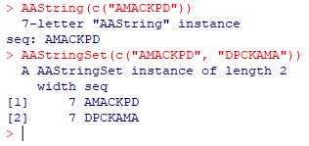
Biostrings
Biostrings contains tools for working with sequences (strings).
The main classes are DNAString, RNAString and AAString. Also, classes for lists such as DNAStringSet and so on.
Many methods for manipulating biological sequences (ex: alphabetFrequency, etc).
Warning in install.packages : package ‘Biostrings’ is not available (for R version 3.6.0)

Slide 7
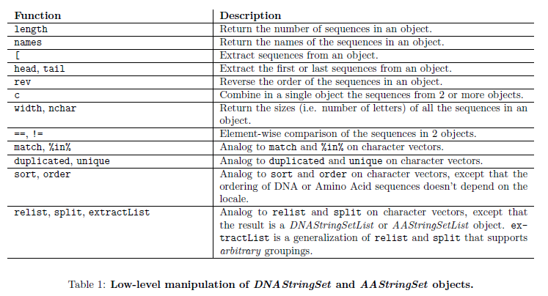
Biostrings
Pages (2019), Biostrings quick overview, Biostrings documentation

Slide 8
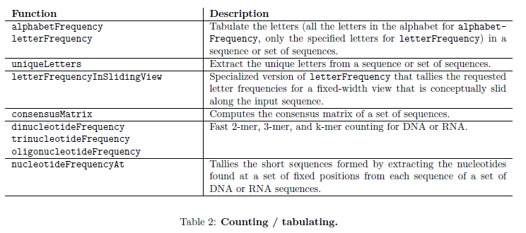
Biostrings
Pages (2019), Biostrings quick overview, Biostrings documentation

Slide 9
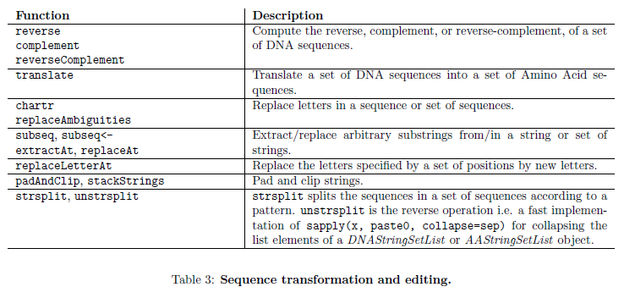
Biostrings
Pages (2019), Biostrings quick overview, Biostrings documentation

Slide 10
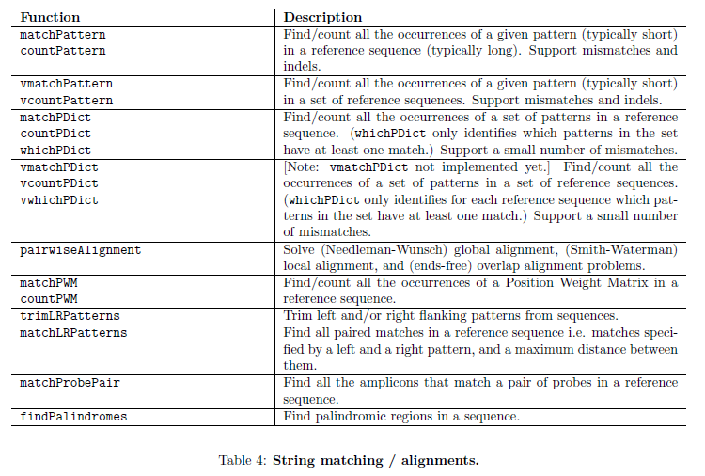
Biostrings
Pages (2019), Biostrings quick overview, Biostrings documentation

Slide 11
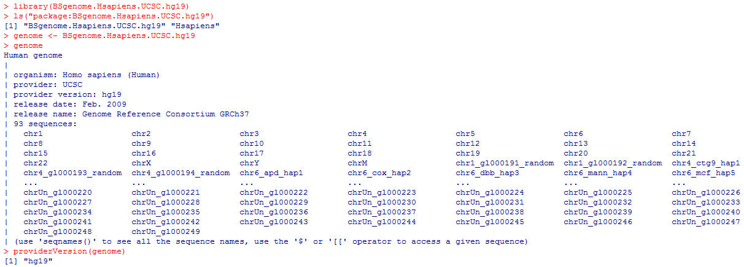
BSgenome
BSgenome is a collection of packages (BS.Hsapiens.UCSC.hg19, BS.Dmelanogaster.UCSC.dm3, and so on), which contain whole-genome sequences.

Slide 12
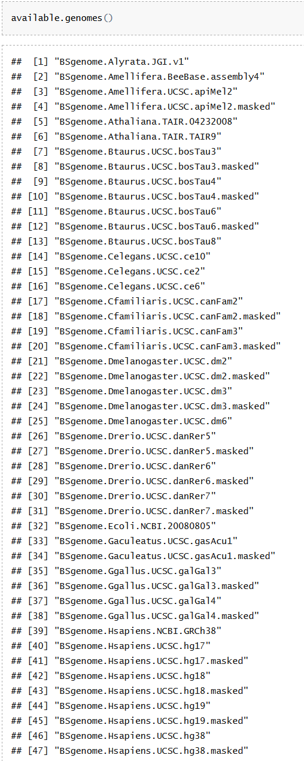
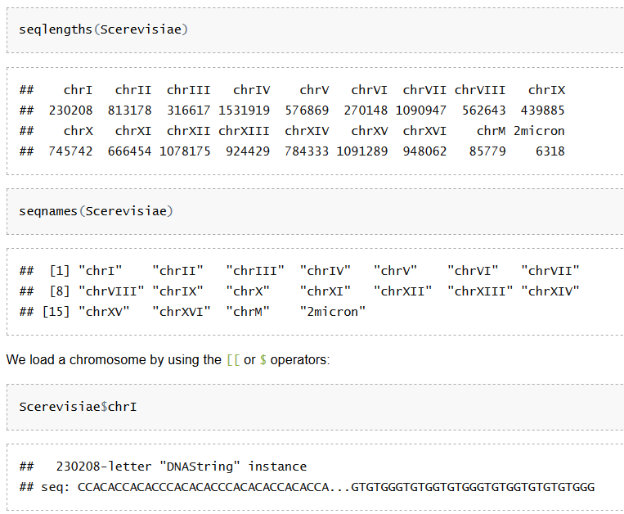
BSgenome
Source: Package documentation

Slide 13
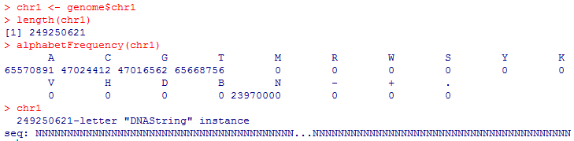
BSgenome
We can also use BSgenome together with Biostrings.

Slide 14
Other examples of working with sequences --ShortRead
ShortRead: Input / manipulation of FASTQ files
Fastq sequence data are represented as DNAStringSet
Fastq quality data are represented as BStringSet

Slide 15
3. Working with Coordinates

Slide 16
Main Packages
IRanges is the package to represent and manipulate ranges. It does introduce classes such as IRanges and Rle, and methods such as those to deal with overlaps.
GenomicRanges is the genomic version of IRanges and it is used to specify genomic coordinates, including information such as strand, sequence name, etc.
GenomicFeatures offers options to retrieve and query public resources with annotation of genomic features (genes, exons, promoters, enhancers, CpG islands, etc). Data is provided as a GRangesList.

Slide 17
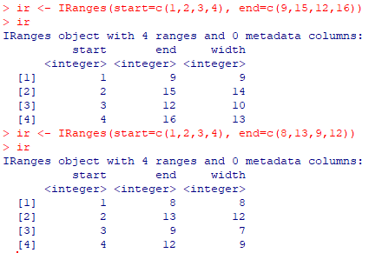
IRanges
IRange is the R way to encode ranges:

Slide 18
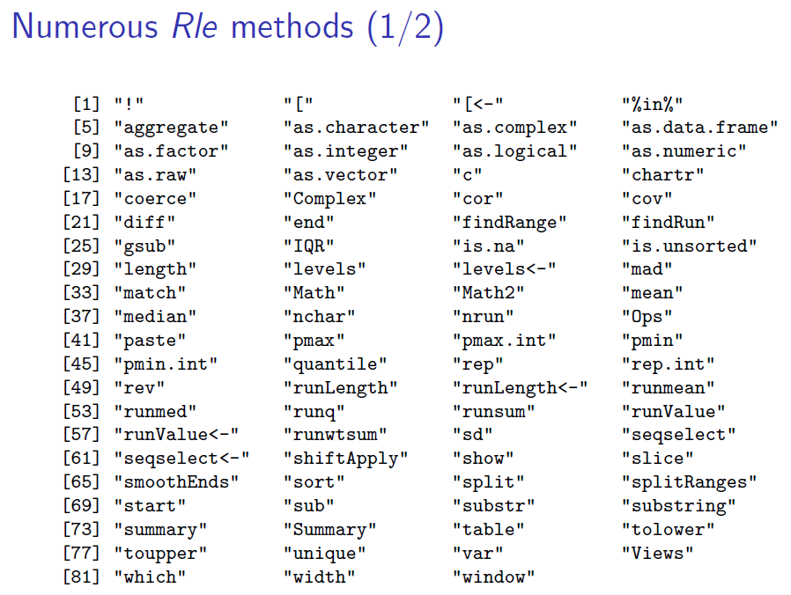
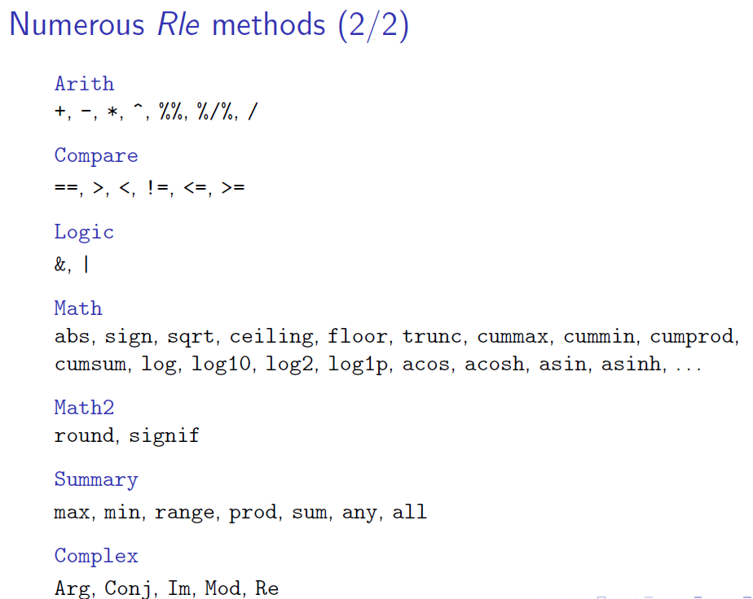
IRanges
IRanges uses Run-Length Encoding (RLE), which is a compression technique to store long and repetitive sequences.
Instead of storing the full sequence, an RLE couples values with run lengths: c(1,1,2,2,2) would be two 1s and three 2s.

Slide 19
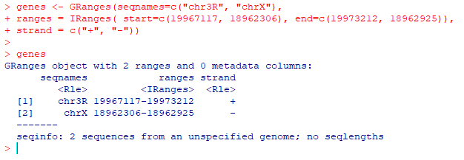
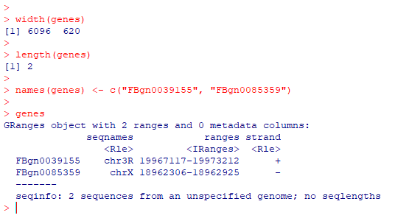
GRanges

Slide 20
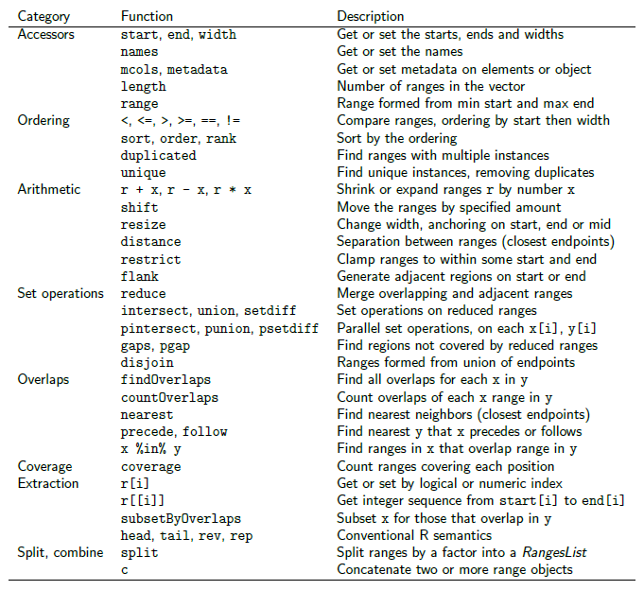
GenomicRanges --Methods

Slide 21
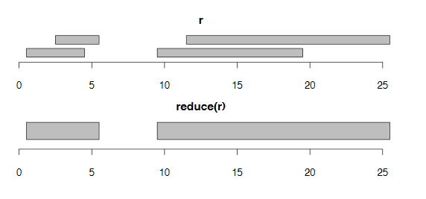
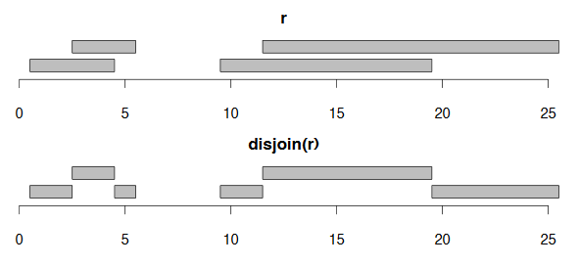
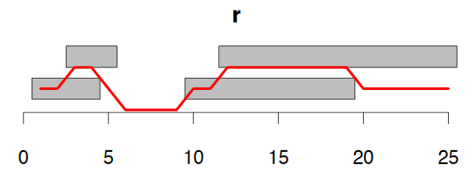
GenomicRanges

Slide 22
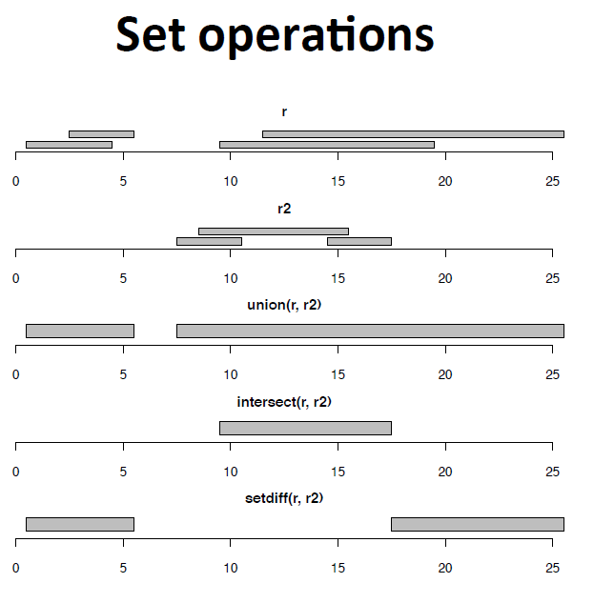
GenomicRanges

Slide 23
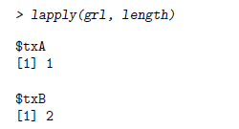
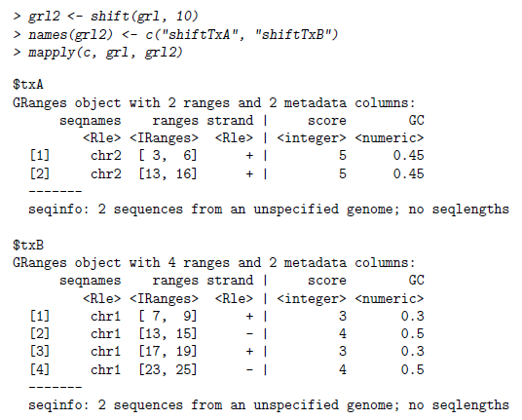
GRangesList
GRangesList is a list of GRanges.
To create: grl = GRangesList(gr1, gr2)
To subset: grl[[1]]
All GenomicRanges methods can be applied to all the ranges in the list at the same time.
Supports “lapply”.

Slide 24
4. SummarizedExperiment

Slide 25
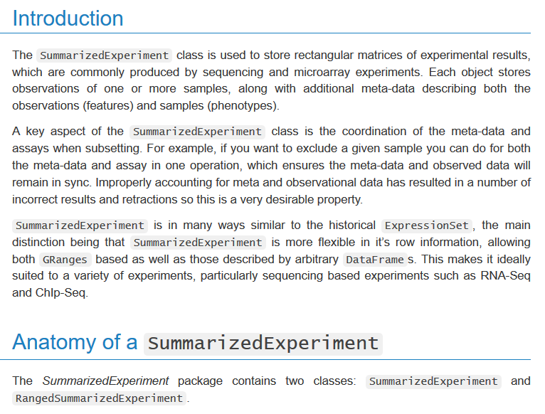
SummarizedExperiment
Source: Package documentation

Slide 26
Now, let’s start the exercises...

Slide 27
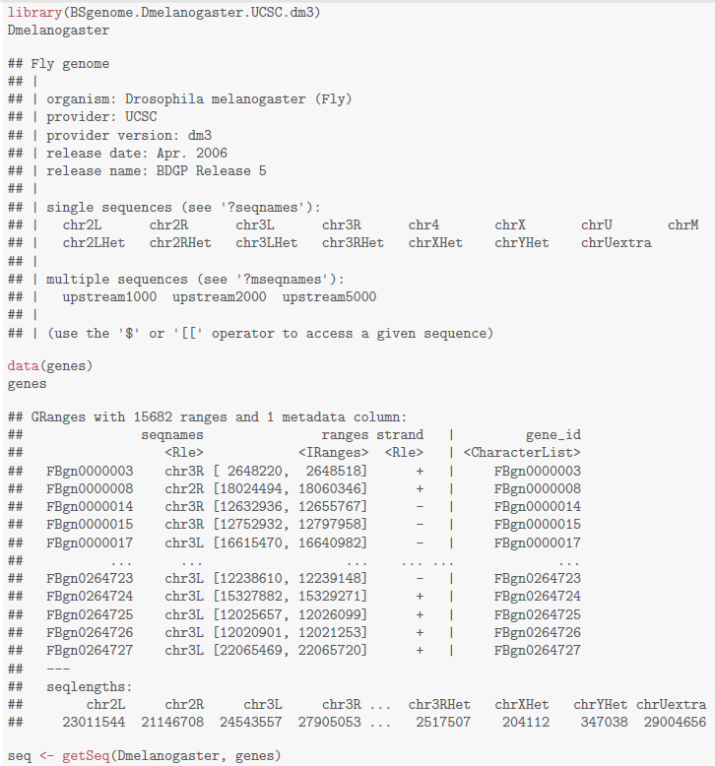
To LAB
https://github.com/kasperdanielhansen/genbioconductor/blob/master/Rmd/BSgenome.Rmd

